Slide 1
SpitFire Game
by Group 6

Slide 2
Concept Pitch - Idea
The team's idea was to create an interactive game centered around piloting a Spitfire, blending engaging gameplay with historical education.
Players would be able to learn compelling facts about an iconic aircraft through a fun experience.
Fit in with current exhibits.
The team aimed to go beyond a standard educational exhibit by making learning immersive and entertaining.

Slide 3
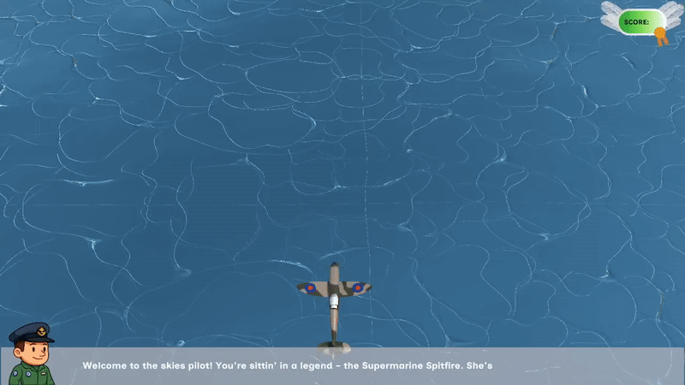

Slide 4
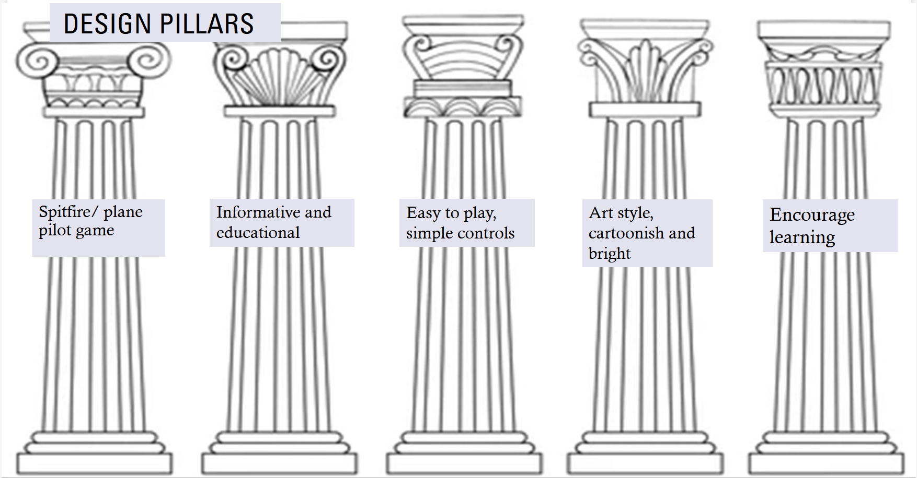
Design Goals vs Final Outcome
Initial Design Pillars: At the start, key goals were defined to guide development:
Focused on piloting a plane – the core gameplay experience.
Informative and educational – integrating historical facts seamlessly.
Simple, intuitive controls – accessible to a wide audience.
Consistent, stylized visuals – a bright, slightly cartoonish style.
Encouraged curiosity and learning – through immersive gameplay.

Slide 5

Design Goals vs Final Outcome
Initial Design Pillars: At the start, key goals were defined to guide development:
Focused on piloting a plane – the core gameplay experience.
Informative and educational – integrating historical facts seamlessly.
Simple, intuitive controls – accessible to a wide audience.
Consistent, stylized visuals – a bright, slightly cartoonish style.
Encouraged curiosity and learning – through immersive gameplay.
Notes:
Final Outcome: The final product successfully reflects these aims:
The Spitfire Piloting mechanic is central and engaging

Slide 6
Design Goals vs Final Outcome
Initial Design Pillars: At the start, key goals were defined to guide development:
Focused on piloting a plane – the core gameplay experience.
Informative and educational – integrating historical facts seamlessly.
Simple, intuitive controls – accessible to a wide audience.
Consistent, stylized visuals – a bright, slightly cartoonish style.
Encouraged curiosity and learning – through immersive gameplay.
Notes:
Final Outcome: The final product successfully reflects these aims:
Educational content is embedded naturally in the game.

Slide 7
Design Goals vs Final Outcome
Initial Design Pillars: At the start, key goals were defined to guide development:
Focused on piloting a plane – the core gameplay experience.
Informative and educational – integrating historical facts seamlessly.
Simple, intuitive controls – accessible to a wide audience.
Consistent, stylized visuals – a bright, slightly cartoonish style.
Encouraged curiosity and learning – through immersive gameplay.
Notes:
Final Outcome: The final product successfully reflects these aims:
The game is easy to pick up and play.

Slide 8
Design Goals vs Final Outcome
Initial Design Pillars: At the start, key goals were defined to guide development:
Focused on piloting a plane – the core gameplay experience.
Informative and educational – integrating historical facts seamlessly.
Simple, intuitive controls – accessible to a wide audience.
Consistent, stylized visuals – a bright, slightly cartoonish style.
Encouraged curiosity and learning – through immersive gameplay.
Notes:
Final Outcome: The final product successfully reflects these aims:
The visual style is cohesive, inviting and memorable.

Slide 9
Design Goals vs Final Outcome
Initial Design Pillars: At the start, key goals were defined to guide development:
Focused on piloting a plane – the core gameplay experience.
Informative and educational – integrating historical facts seamlessly.
Simple, intuitive controls – accessible to a wide audience.
Consistent, stylized visuals – a bright, slightly cartoonish style.
Encouraged curiosity and learning – through immersive gameplay.
Notes:
Final Outcome: The final product successfully reflects these aims:
Players are prompted to learn through interaction, not just observation.

Slide 10
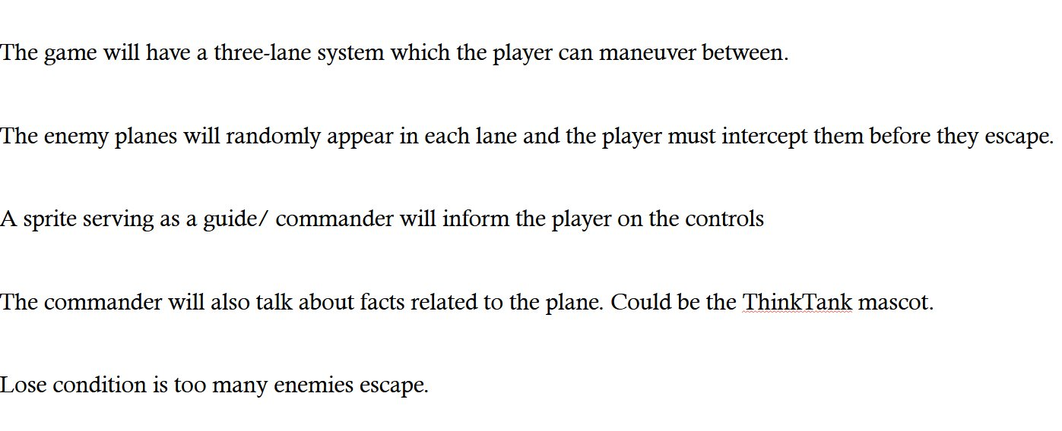
Gameplay - Original

Slide 11
Gameplay - Final Outcome
Final Outcome:
Three-lane system for enemies to spawn in, the player flies freely between them
Player intercepts the enemies, can't score if they get by
Sprite character teaches controls
Sprite talks about plane facts
No lose condition, different medals to obtain

Slide 12
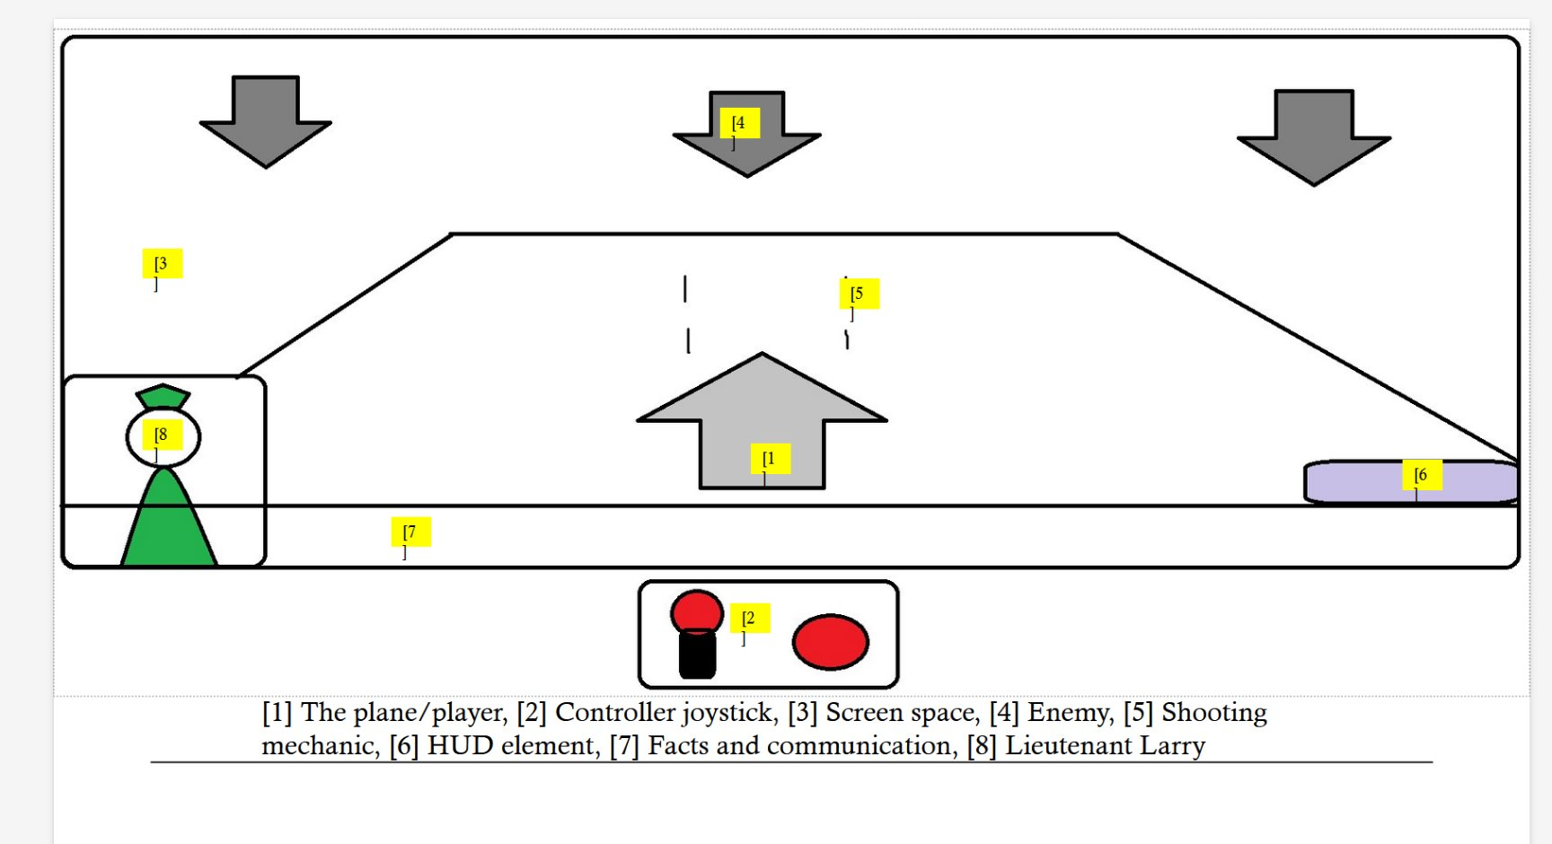
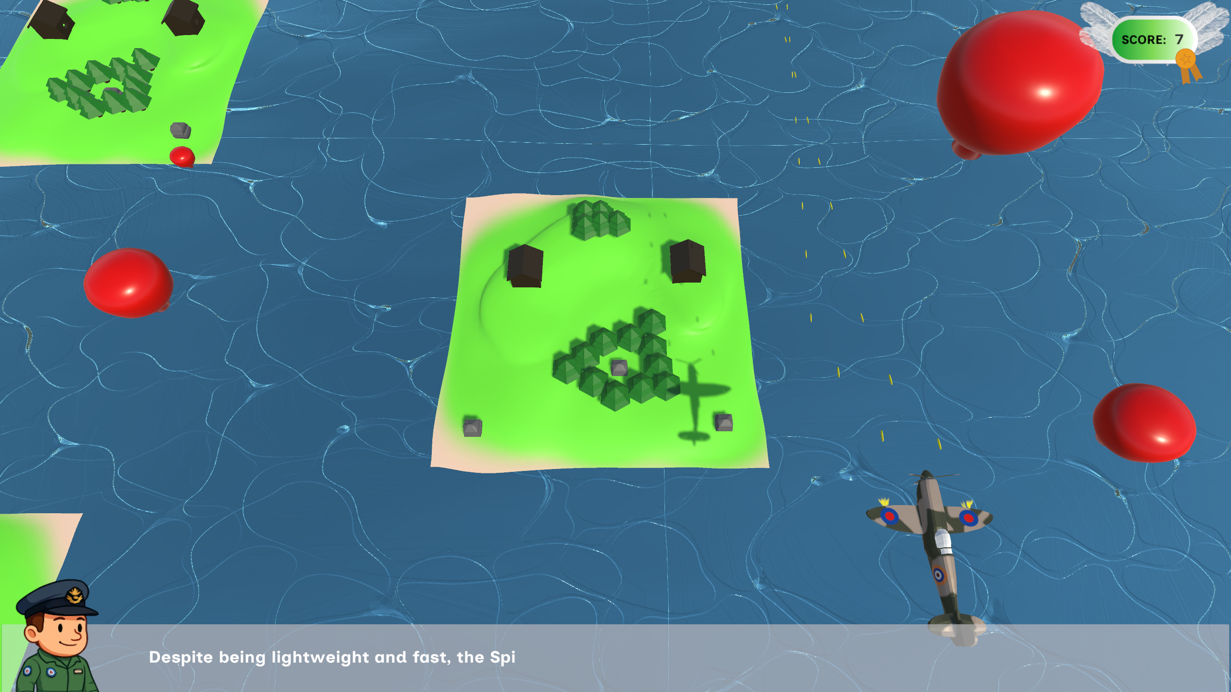
Before/ After
Initial concept
Completed project

Slide 13
Project Management & Development Process
Timeline & Planning: Preplanning ensured smooth workflow
8-week production schedule (from original pitch)
Finished before the Easter break
Team Coordination:
Weekly check-ins to track progress and address challenges
Clear communication kept everyone aligned
Development Practices: Foresight in planning led to a smooth development cycle
Used GitHub branches to prevent merge conflicts
Stayed within the original project scope
Maintained clear file naming system/ folder structure
Notes:
Merge Conflicts & Lost Work
Without using GitHub branches, team members could accidentally overwrite each other’s work, especially when editing the same files.
By creating separate branches for features, everyone worked in parallel without issues, and merges were smoother.
Scope Creep
When teams add new features mid-way through development, it can delay the project or dilute the original vision.
By sticking to the original goals and not overextending, we kept development focused and on time.

Slide 14
Team Collaboration
Team Effectiveness:
Roles were clearly defined and well executed.
Strong communication was maintained through regular check-ins and updates through Teams chat.
Tasks were distributed fairly, preventing overload on any individual team member.
Adaptability & Responsiveness:
The team adapted quickly to challenges and feedback.
Changes were handled effectively without major disruption to the timeline.
Notes:
The team adapted quickly to challenges and feedback. For instance, pivoting from enemy planes to more child friendly training balloon targets.
Changes were handled effectively without major disruption to the timeline. For instance, adjusting workloads when accounting for abscences

Slide 15
Accessibility Considerations
Inclusive Design Choices:
High contrast visuals
Improves readability and visibility for players with visual impairments.
Text & audio narration
Supports players with reading difficulties or vision challenges, and ensures information is accessible in multiple formats.
Accessible & readable font used throughout.
Simple controls
Just left/right movement and a single action button
Makes the game approachable for players with limited mobility or unfamiliarity with gaming
Straightforward mechanics
Keeps gameplay intuitive and reduces cognitive load, making it easier for all players to understand and enjoy the experience.
Notes:
Used multiple solutions for accessibility challenges.
Accessibility not only broadens the audience but aligns with museum goals of making education available to everyone.

Slide 16
Target audience
Intended Audience:
Designed primarily for children aged 6-14
Simple, fun gameplay captures attention quickly
Easy to understand controls and mechanics
Short digestible facts
Contextual Fit:
The game was developed with a museum setting in mind
Players are visiting for education and engagement – which the game supports

Slide 17
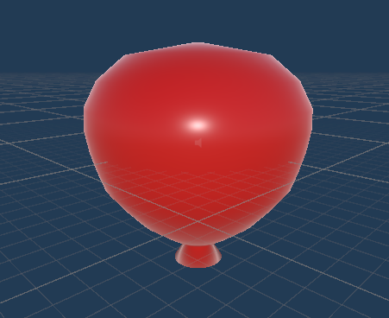
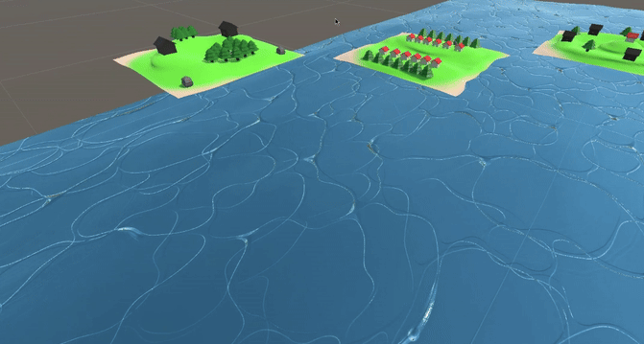

Programmers – Joshua
I was initially placed in charge of level generation this consisted of
Having level "chunks" that procedurally generate in the level
Modelling the chunks and balloons and creating particle effects for shooting
Water shader for more realism
Creating the subtitles on screen
Menu interactions
Assisting with any colleague's code when help was needed.

Slide 18
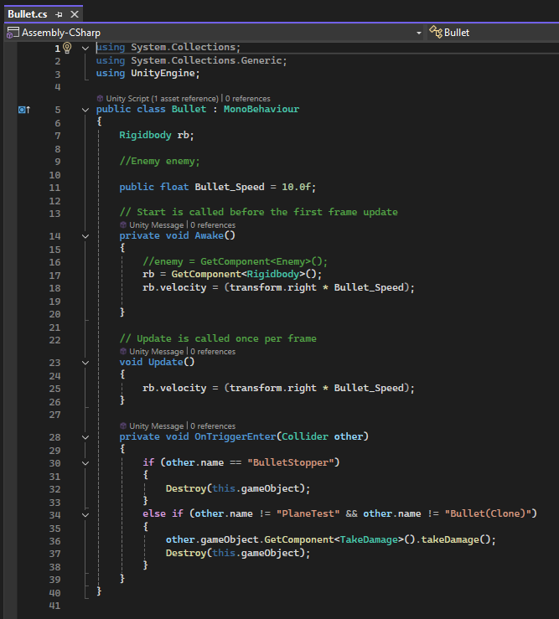
Programmers - Morgan
Example of my code
I made the shooting mechanic, which is one of the fundamental mechanics of the game
I also helped to make a final build of the game
I collaborated with the team's programmers providing a second opinion

Slide 19
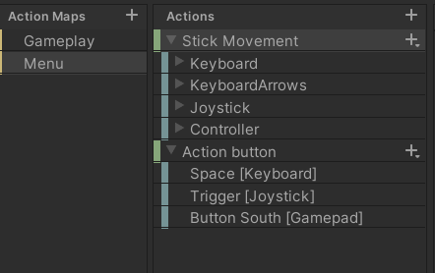
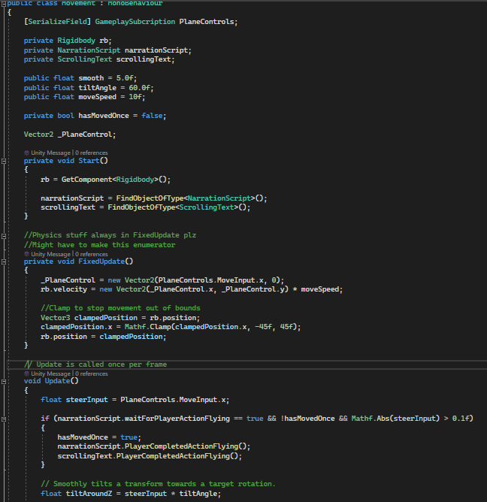
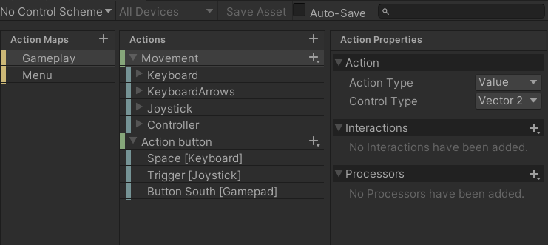
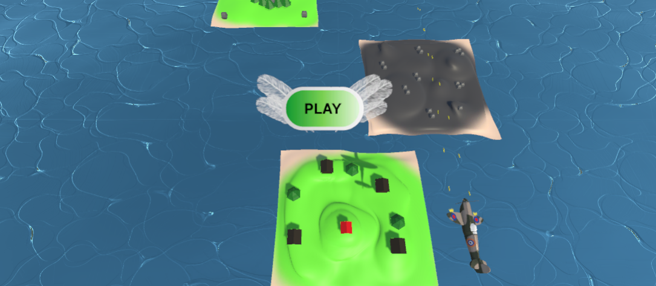
Programmers - Sean
Implemented an input mapping to standardize the control scheme for various controllers and inputs.
Developed the main movement code.
Created the main menu Attraction sequence.

Slide 20
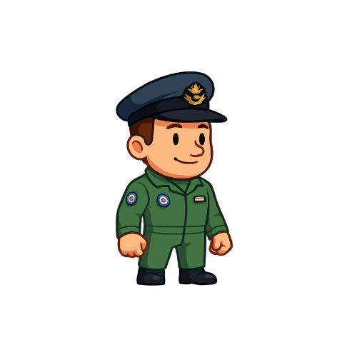
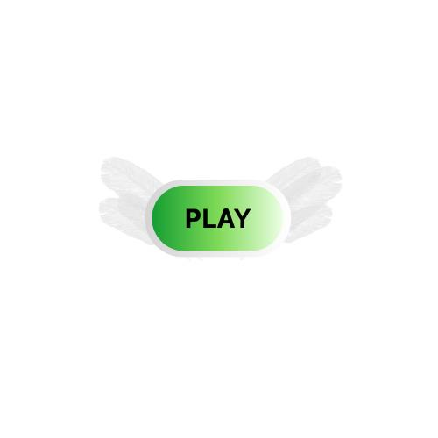

Artist: (UI & Visual Elements) - Oseyem
My role was to create the visual elements for the game. I designed the ‘Play' action button, the 'Score' button, making sure to leave space for the actual score value to be displayed and I made the medals that the player could receive. I also created the sprite and the RAF symbol used in the game. These were created using Canva.

Slide 21
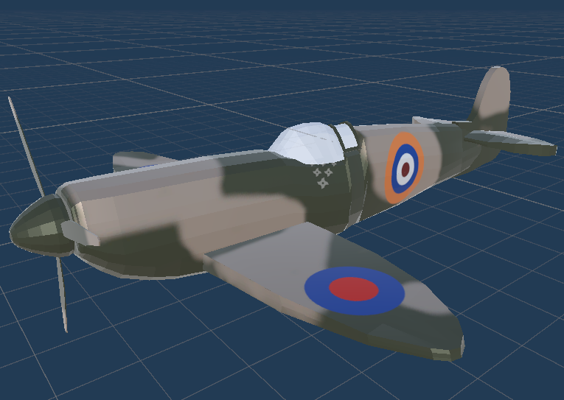
Artist: (VFX) Mustafa (Modelling, Texturing)
My role was in content creation; I was responsible for creating assets required for the project
The pipeline was established early on with a Maya-> Substance Painter-> Unity workflow
I created the main Spitfire Model on Maya
I created the textures the Model on Adobe Substance
The role that was assigned to me had a straightforward plan and a good workflow for me to create this within a realistic timeframe

Slide 22

Audio: (Editing and Recording) Georgina Betts
Helped to setup the recording facility, this included suggestions on best practices for the software and recording techniques.
Edited all of the audio clips, this involved adding effects to simulate radio dialogue and cutting clips to ensure no empty space.

Slide 23
Product lead: James Roper
Organise a production plan, ensure timely progress and clearly delegate tasks with achievable goals.
Help create a realistic, attainable project from which we developed a wider scope. Played to strengths of the team, primarily comprised of Game Developers, settled on a game idea.
Weekly diary was kept that surmised each week's progress, additionally there were objectives to be met set the at the start of the day with a rough outline of the tasks.
Multi role flexibility to assist when a problem arose, this could be with troubleshooting code or learning new techniques to assist with asset creation.

Slide 24
Challenges & Problem Solving
Technical Issues/ Management:
Broken model prefab – resolved by changing the file type (MB to FBX).
Input mapping not registering – Identified and fixed input mapping setup.
Avoided merge conflicts by utilising GitHub branches.
Kept within original scope, avoided late features that could introduce bugs.
Lateral Thinking:
Organising a Teams call outside of normal hours to assemble final presentation collaboratively.
Choosing a game instead of alternative exhibits.
Accessibility solutions i.e. both scrolling text and audio narration.
Problem Management:
Problems were identified early whenever possible.
Adaptive planning and quick action ensured issues didn’t derail progress.
Notes:
Avoided merge conflicts by utilising GitHub branches. Preventative solution — a technical problem that was avoided by smart planning.
Choosing a game instead of alternative exhibits. Team was mainly composed of game developers. adapting the project concept to the team's strengths, ensuring the project was realistic and achievable.

Slide 25
Team Strengths
Constant updates kept the project moving smoothly.
Team members regularly supported one another to meet goals.
The planned goals were realistic and established early.
Project ambitions were achievable, avoiding unnecessary stress.
Each member completed their tasks reliably and on time.
Workloads were balanced, leading to consistent progress.
Notes:
Good communication and careful planning created an environment where the team could focus on doing good work without unnecessary pressure

Slide 26
Overall Project Analysis - Advantages
Clear role assignment meant everyone knew who to approach for help.
Communication stayed focused and efficient throughout development.
Everyone preformed their work with minimal issues or complaints.
Early organisation allowed the team to stay coordinated and responsive.
Notes:
By assigning roles early and keeping communication open and structured, we avoided confusion and stayed productive across the whole project.

Slide 27
Overall Project Analysis - Challenges
Technical hiccups (e.g., broken model exports, input mapping issues) caused short-term delays.
Late-stage stress during final presentation preparations required out-of-hours collaboration.
Notes:
Minor technical issues showed that even better early testing/checking of file types and controls could have saved time.
While the team adapted well under pressure ,building a stronger final-week buffer into the schedule could have reduced the need for last-minute meetings.

Slide 28
Game Demo

